Slide 1
INTRODUCTION TO DATA SCIENCE
Nicholas Russo

Slide 2
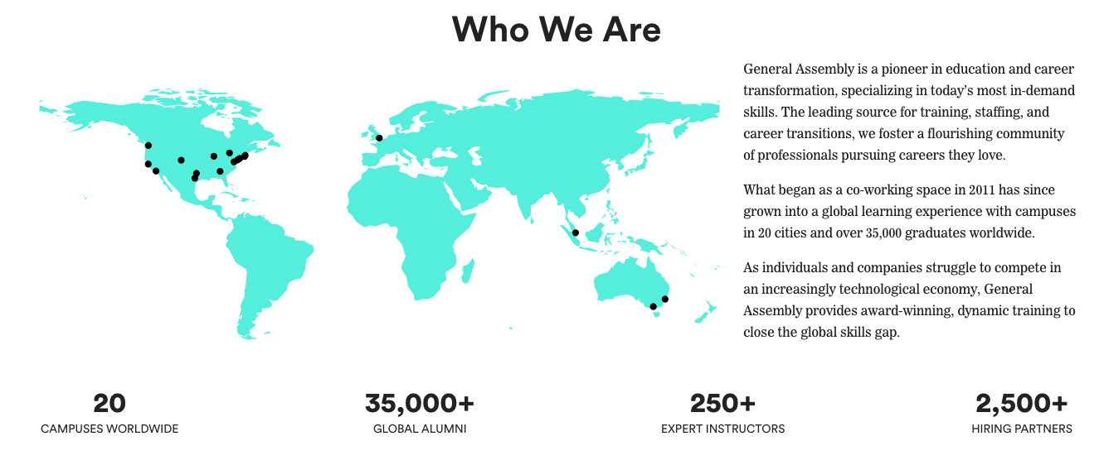

Slide 3




Who I Am
Notes:
Give a brief intro to my experience

Slide 4
INTRODUCTION TO DATA SCIENCE
AGENDA
Introduction
What Is Data Science?
How Is Data Science Used?
Data Science Workflow
Practical Data Science
Questions and Next Steps
Notes:
Roadmap of next two hours

Slide 5
WHY LEARN DATA SCIENCE?
Notes:
Ask the audience why they are here.
What are their current jobs?
What do they hope to learn.

Slide 6
WHAT IS DATA SCIENCE?
Notes:
Ask the audience what they currently understand DS to be.
Ask what problems can be solved with DS.
What example in their current role could benefit from DS knowledge.

Slide 7
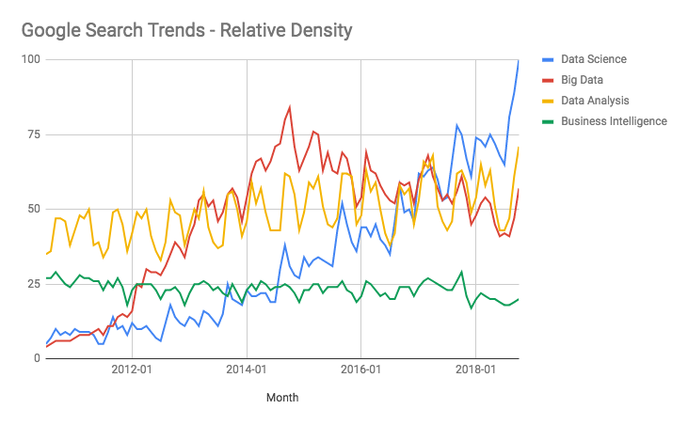
WHAT IS DATA SCIENCE?
Notes:
Compare trends between the linked search terms
Explain the y-axis

Slide 8
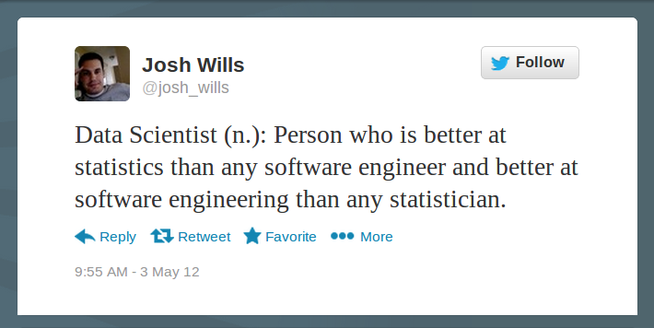
WHAT IS DATA SCIENCE?
Notes:
Open with this famous quote - conventional wisdom, now replaced with more nuance.
Explain the flaws, doesn’t take into consideration business problems.
Data Scientists must interact with the business to solve problems - using computers to leverage their analytical skills.
DS is mostly agnostic of tools, it is all about problem solving.

Slide 9
WHAT IS DATA SCIENCE?
“Information is the oil of the 21st century, and analytics is the combustion engine.” – Peter Sondergaard, SVP, Gartner Research.
"A data scientist is someone who has augmented their math and statistics background with programming to analyze data and create applied mathematical models.."- Jesse Anderson, O’Reilly Media
"A data scientist is someone who can obtain, scrub, explore, model and interpret data, blending hacking, statistics and machine learning. Data scientists not only are adept at working with data, but appreciate data itself as a first-class product." - Hillary Mason, Data Scientist
Notes:
Simple high level to detailed description

Slide 10
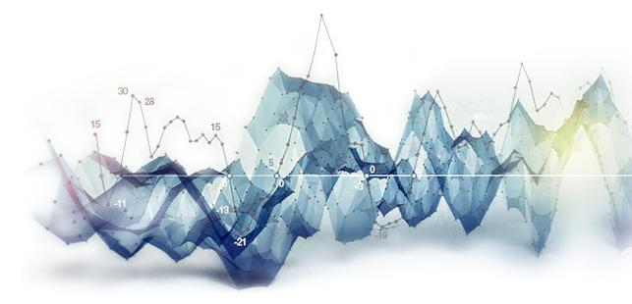
WHAT IS DATA SCIENCE?
THE OFFICIAL ANSWER
A set of tools and techniques used to extract useful information from data
An interdisciplinary, problem-solving-oriented subject
The application of scientific techniques to practical problems
A rapidly-growing field
Notes:
This is GA specific answer. It covers a broad church of employees within the business and scientific arenas.

Slide 11
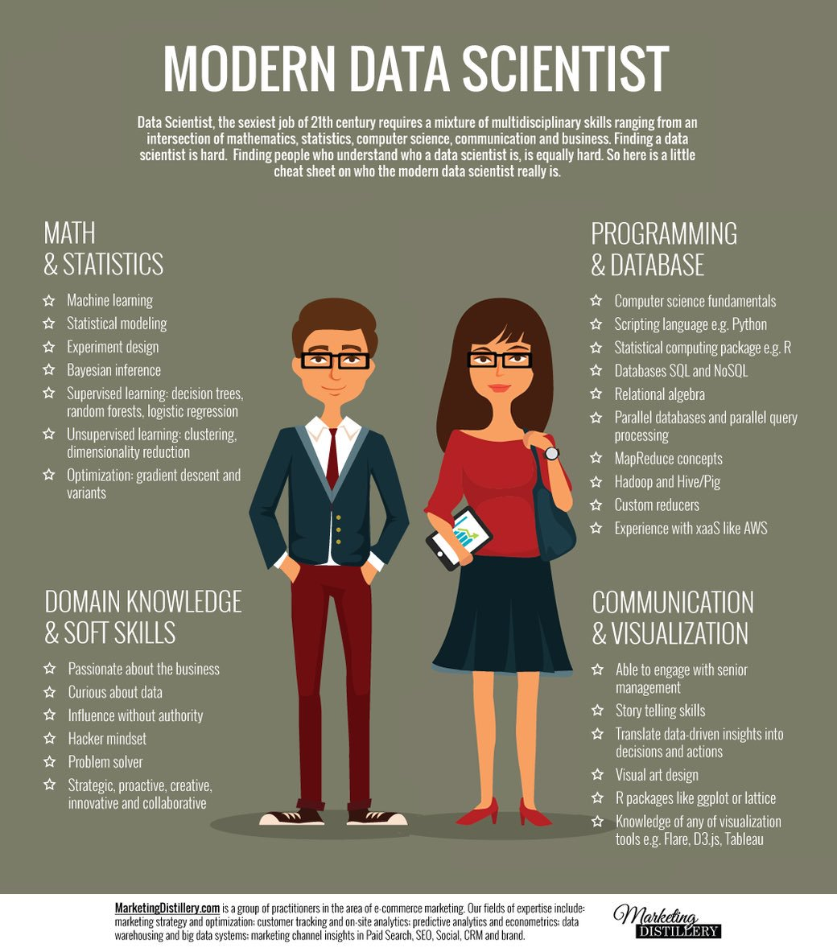
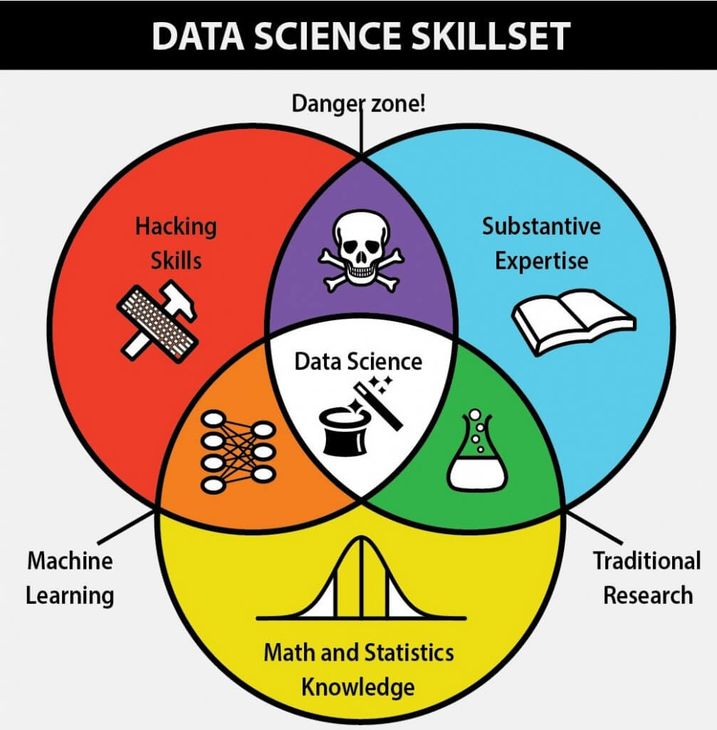
WHAT IS DATA SCIENCE?
Notes:
Discuss the Predictim issue in danger zone. Baby sitting service scraping social media data.

Slide 12
INTRODUCTION TO DATA SCIENCE
HOW IS DATA SCIENCE
USED?
Notes:
Ask Audience for examples of DS in industry

Slide 13









Slide 14
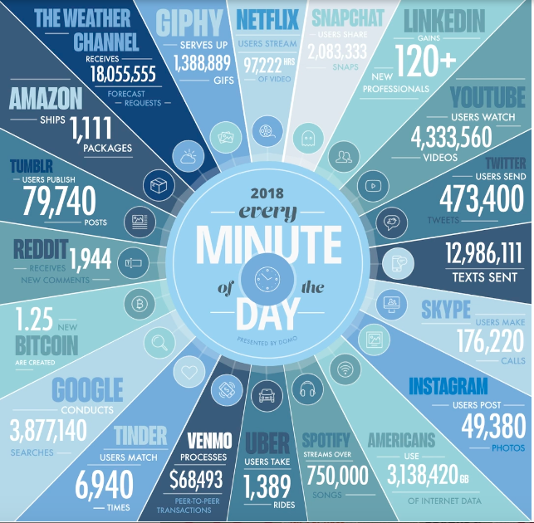
WHAT IS DATA?
The Four 4 V’s of Data?
Volume
Veracity
Variety
Velocity
Image: https://www.domo.com/blog/data-never-sleeps-6/
Notes:
Domo put this chart out every year with updated metrics.
Trends are only going in one direction - up!

Slide 15
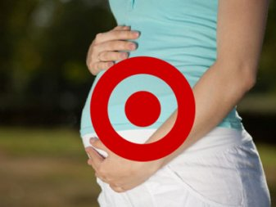
HOW IS DATA SCIENCE USED?
“TARGET KNEW I WAS PREGNANT”
DS team analyzed buying patterns of women on baby registries
Trends emerged: Specific lotions and vitamins in 2nd trimester Switch to scent-free products in 3rd trimester Colored items signifying gender
Marketing team used this data to send coupons
Some family surprises…
Notes:
Familiar tale to all aspiring data scientists, target build a model based on basket at checkout time to understand when its customers would be recepticle to pregnancy related products. Predicted a teenager as a positive sample, father of teen was furious and then discovered his daughter was in fact pregnant.
Post this event - coupons now hidden amongst other unrelated offers to make recipient more comfortable.

Slide 16

HOW IS DATA SCIENCE USED?
NETFLIX PROGRAMMING DECISIONS
Features: When user watches and for how long Where and on what device the user is watching Rewinds, pauses, fast-forwards
Same categorization for current programming used to determine new content (Animated / Comedy / 18-29 / Cynical / 30 min / etc.)
Notes:
Discuss the Netflix competition - origin of kaggle.

Slide 17

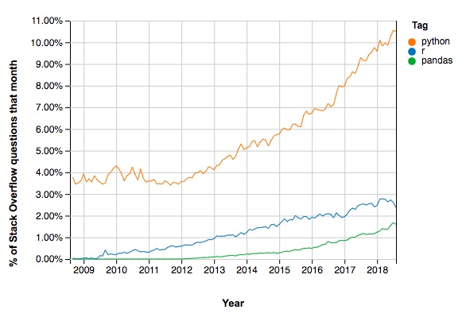

Data Science Tools
Notes:
Discuss popularity of Python
Chart is not a fair comparison, python also extensive web dev eco system
However, pandas one library of data sci flow is almost equiv to R

Slide 18
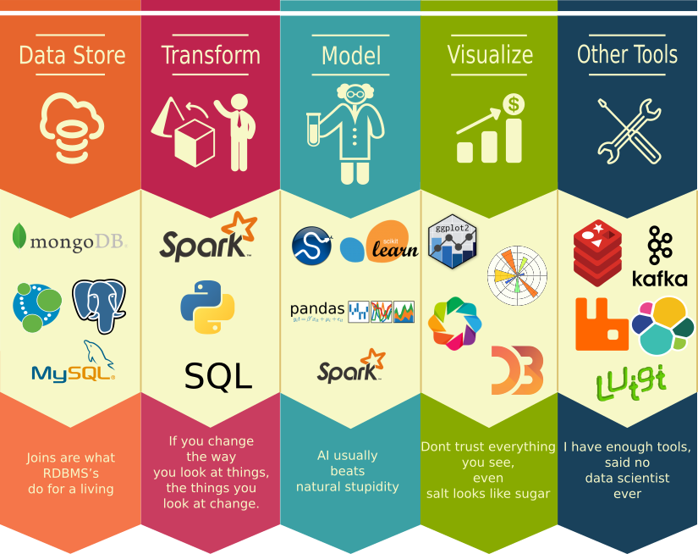
Data Science Toolkit - Expanded
Notes:
More technologies - touch on briefly the different libraries and tech stacks that supplement the day to day life of a DS.

Slide 19
HOW IS DATA SCIENCE USED?
FEATURES
Functions: values in, value out
y = f(x₁, x₂, x₃…)
x: independent variable(s) (input)
y: dependent variable (output)
y can be specific value, binary Yes/No, 0 to 1 confidence, categories…
Other names for x: predictor, regressor, explanatory variable, feature
Other names for y: response, target, explained variable, outcome, label
Notes:
Discuss what a model is - what are features used for. Describe f(x).

Slide 20
HOW IS DATA SCIENCE USED?
FEATURE TYPES
Nominal | Ordinal
Interval | Ratio

Slide 21
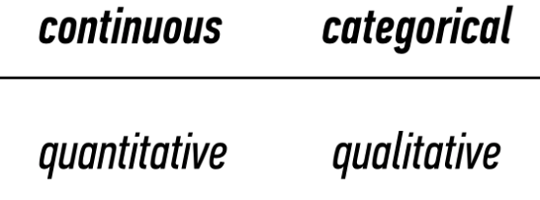
HOW IS DATA SCIENCE USED?
CONTINUOUS VS. CATEGORICAL

Slide 22
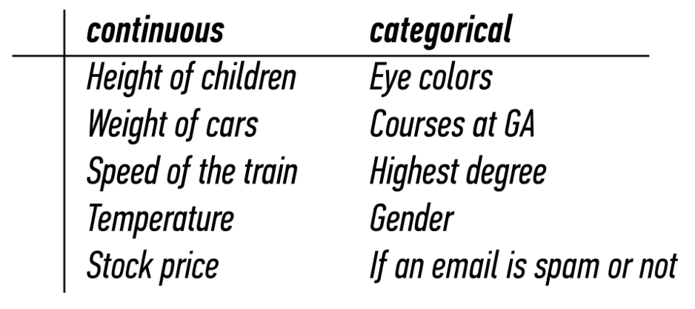
HOW IS DATA SCIENCE USED?
CONTINUOUS VS. CATEGORICAL

Slide 23
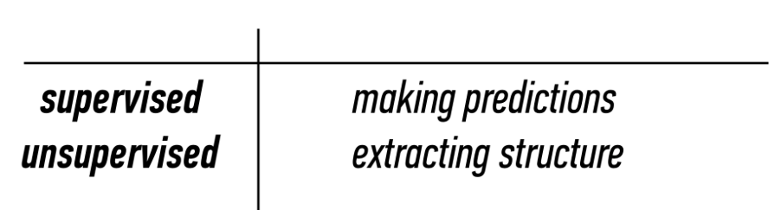
HOW IS DATA SCIENCE USED?
SUPERVISED VS. UNSUPERVISED
Supervised: Generalization
Unsupervised: Representation

Slide 24
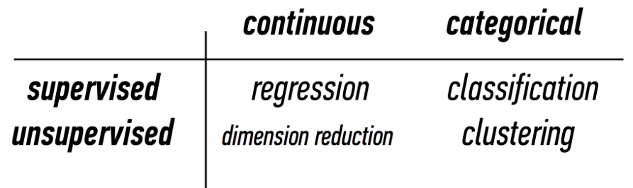
HOW IS DATA SCIENCE USED?
MACHINE LEARNING PROBLEMS

Slide 25
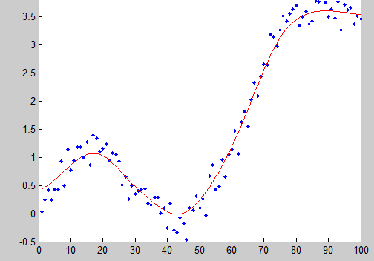
HOW IS DATA SCIENCE USED?
REGRESSION (CONTINUOUS, SUPERVISED)
Build a model that best fits data
You’ve probably done this before
Minimize error without overfitting
Predict a (continuous) value
Excel can do this! (“Add Trendline…”)
Linear regression, logistic regression…

Slide 26
HOW IS DATA SCIENCE USED?
MACHINE LEARNING PROBLEMS

Slide 27
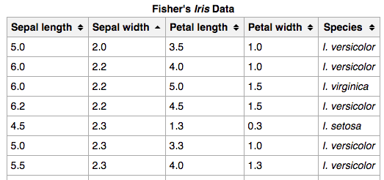
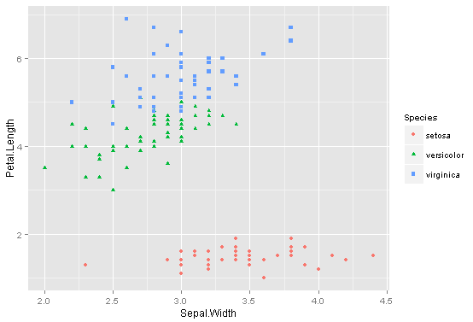
HOW IS DATA SCIENCE USED?
CLASSIFICATION (CATEGORICAL, SUPERVISED)
Map feature vectors to categorical target classes.
Ex: species of iris from petal/sepal sizes
K-Nearest Neighbors, Naïve Bayes, Random Forest…

Slide 28
HOW IS DATA SCIENCE USED?
MACHINE LEARNING PROBLEMS

Slide 29
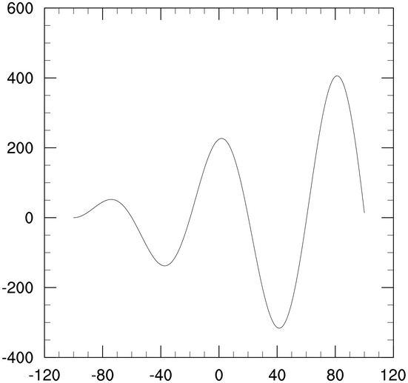
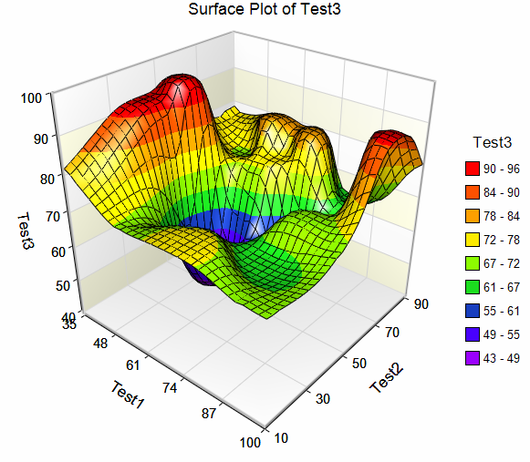
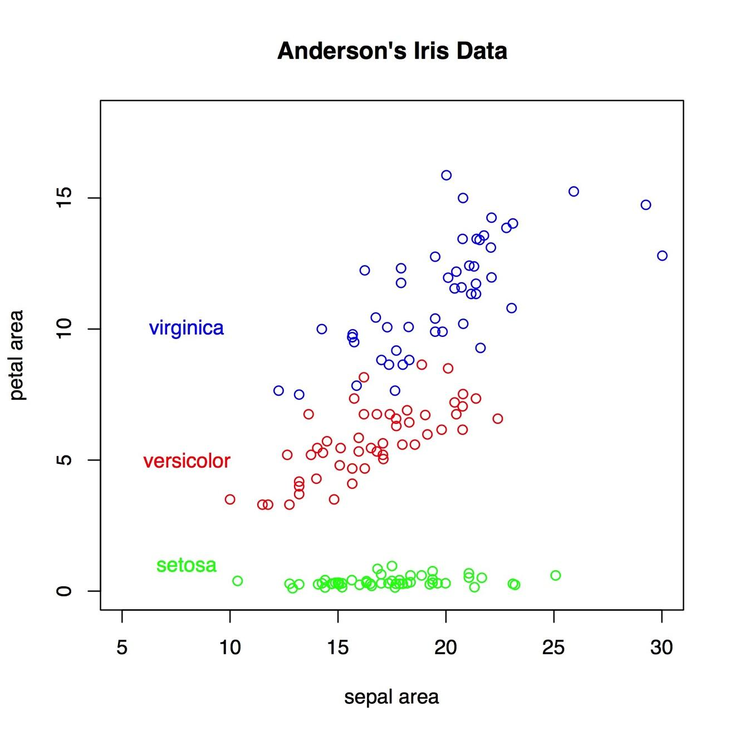
HOW IS DATA SCIENCE USED?
DIMENSIONALITY REDUCTION (CONTINUOUS, UNSUPERVISED)
Every new feature adds a dimension
Higher dimensions harder to visualize
More computationally intensive
Reduces multicolinearity
In short: collapse features
Correlated Ex: Height and Weight
Biomedical Research - Genes
Notes:
Draw out table to clarify dimensions = features
Explain multicolinearity, example height and weight
Gene research has huge number of dimensions - need collapsing

Slide 30
HOW IS DATA SCIENCE USED?
MACHINE LEARNING PROBLEMS

Slide 31
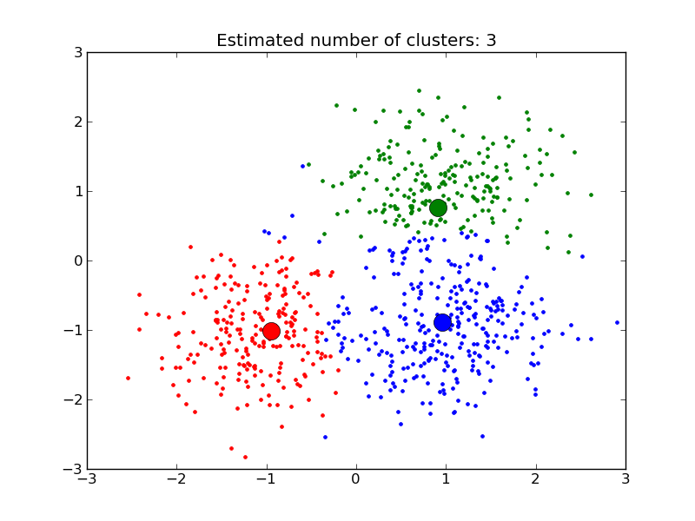
HOW IS DATA SCIENCE USED?
CLUSTERING
(CATEGORIAL, UNSUPERVISED)
Similar to classification, except no labels/classes provided
Purpose is representation – anything that helps you better understand the data
Finding common threads that a human couldn’t see (harder with higher dimensions)
K-Means, Density-Based, etc.
Notes:
Great example of this is supermarkets - what do similar baskets tell us about a person

Slide 32
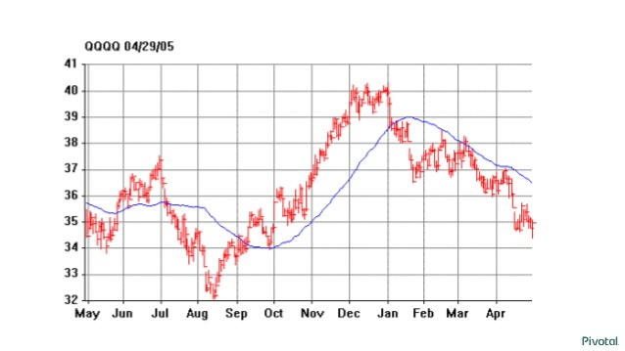
HOW IS DATA SCIENCE USED?
WHAT TYPE OF PROBLEM? – STOCK PRICES
Notes:
Ask audience what type of problem they think this is

Slide 33

HOW IS DATA SCIENCE USED?
WHAT TYPE OF PROBLEM? – MORTGAGE APPLICATION
Age
Gender
Annual salary
Years in job
Current debt
Credit score
…
Notes:
Ask audience what type of problem they think this is

Slide 34
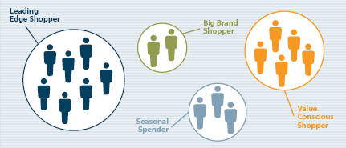
HOW IS DATA SCIENCE USED?
WHAT TYPE OF PROBLEM? – CUSTOMER SEG
Notes:
Ask audience what type of problem they think this is

Slide 35
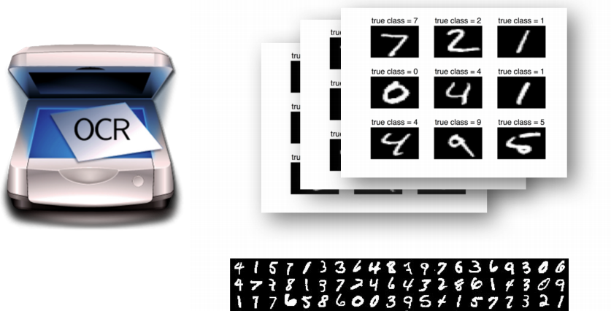
HOW IS DATA SCIENCE USED?
WHAT TYPE OF PROBLEM? – OCR
Notes:
Ask audience what type of problem they think this is

Slide 36
DATA SCIENCE WORKFLOW

Slide 37

DATA SCIENCE WORKFLOW
Image: https://docs.microsoft.com/en-us/azure/machine-learning/team-data-science-process/overview

Slide 38
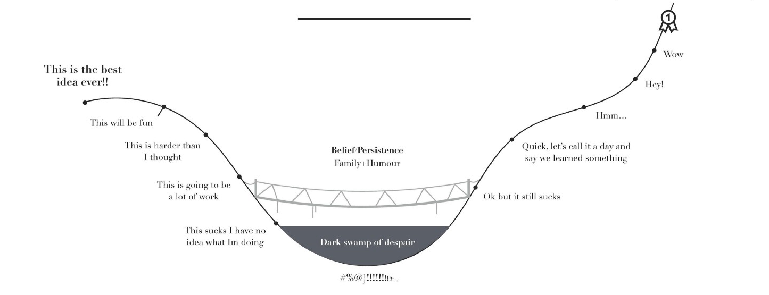
DATA SCIENCE REALITY

Slide 39
PRACTICAL DATA SCIENCE
https://github.com/n-russo/DataScienceIntro

Slide 40
Please share your feedback
ga.co/survey
Mobile & Laptop Friendly

Slide 41
INTRODUCTION TO DATA SCIENCE
WRAP-UP
What Is Data Science?
How Is Data Science Used?
Data Science Workflow
Practical Data Science
Questions and Next Steps

Slide 42
INTRODUCTION TO DATA SCIENCE
Q&A

